Slide 1
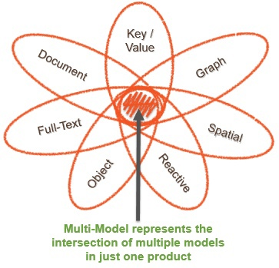
Multi-model database
Examples:
MarkLogic
ArangoDB
OrientDB
Azure Cosmos DB
FoundationDB
Couchbase
Apache Ignite

Slide 2
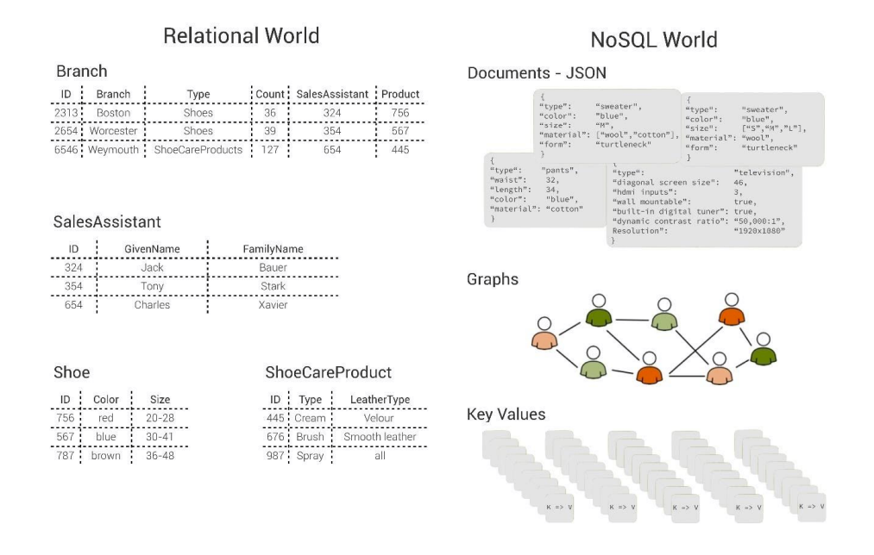
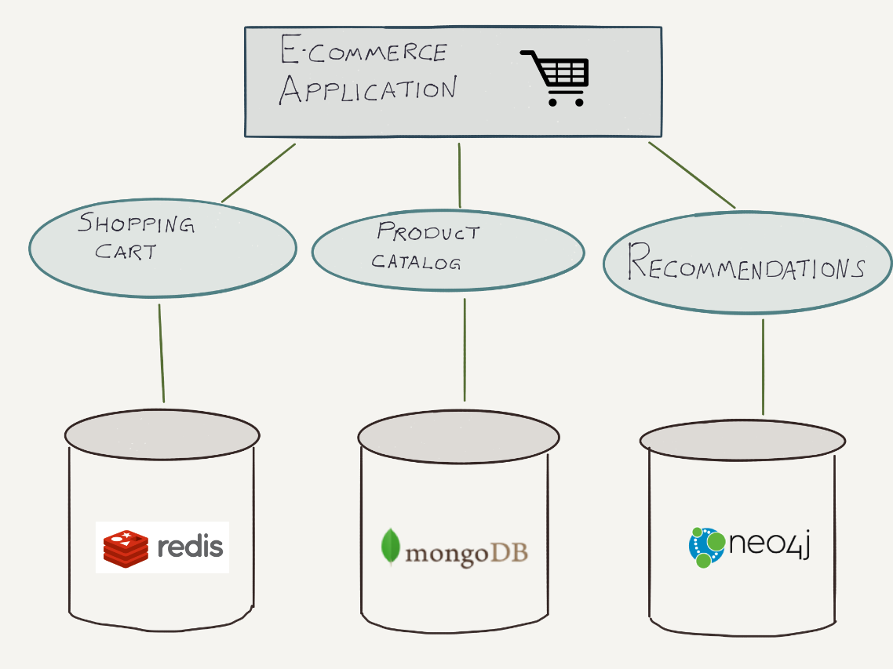
Approach multi-model database
Native Multi-Model Database
Polyglot Persistence

Slide 3
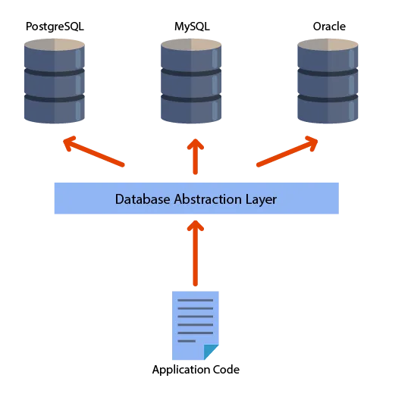
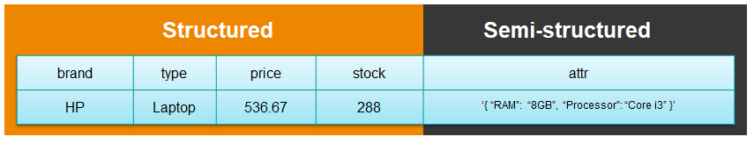
Multi-model database
Database Abstraction Layer
Hybrid Databases

Slide 4
Thank You!

